Slide 1
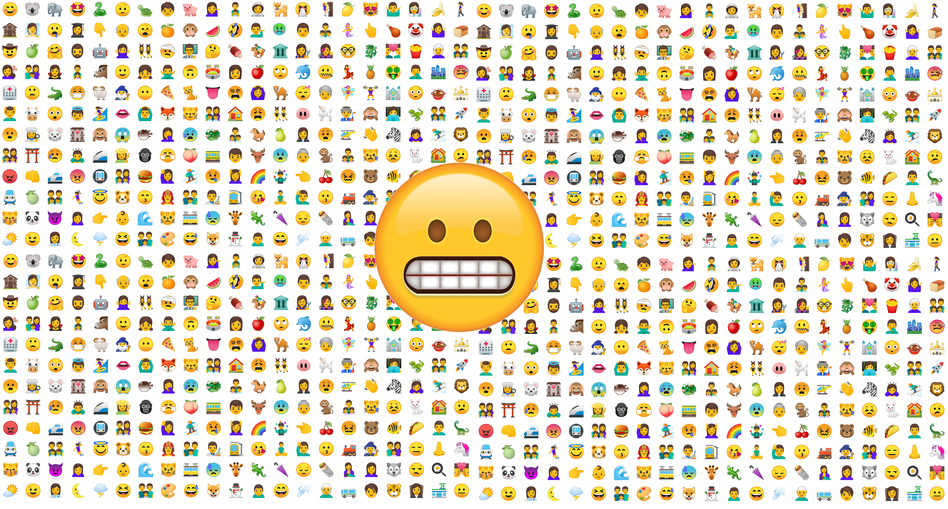
Emoji Dataset

Slide 2
Table of Content
0️⃣ Introduction 1️⃣ Emojis Selection 2️⃣ Quantity Needs 3️⃣ Data Collection 4️⃣ Post-processing 5️⃣ Validation

Slide 3
0️⃣ Introduction
🙂
Notes:
Not talking about 1-2 emojis

Slide 4
0️⃣ Introduction
🙂😂😭❤😍✨🤣🏻🔥💕💜👏🙏💙😊♥♀💖🥺‼👍🥰💛🎉😘☺🤔♂💦🏼💗🎁💚🏽😁😆👇💓🤦🌸💔😅🏾🙌💪😔🙄👉❗😢👀🖤😎🌹🇸👌💞😉😳😩💀🤗🎶✌😱🏆❣🌟😌🇺🤷💥🤤🇷😇🚨⭐😋😡✔💘🤩🐰😈💋💯🔴✅😏🤪▶⚠🙇☀🇪🤭🇦🌈🙈🎊😄💫👑⚡🙂😜🎵🍀➡😀🧡😃🙋🌻🙃🥳🎂⬇✊🇳⚽🤧🗣💃🐶🇹👊😤📸🇬🍑😒🦋🐥😫🌷❌🐯🇧❄😴🇨👋🇵🍃🌺🇮🏿😝☹💢👩📍🌼⚪💝💐🎥💰🏃🐱😚😻💎🎄🍓😣😪😬🙆😑©✋🤮🎀👈🌿♻👨🎈⁉📷🌙😥✈🇰😹🇲🥴🤘🤡🔵🤯😞📣🌚☁☝🤢👅💨📢📌🍆🐻🌕🍒🕊☕▪🥵📱❓🤙🚀🌱📺😐🤬🙊🌞🎤🔞🌑🦁😠🌴🌊😛🤟💧😓🔗💸🔁⚫💭🕯👧🤞🤝🇩🇭🎧💩🤫💌🕺🐾🇴😲😰👦👼😖🎬🧐🤠💵😕🇱🔸😮🔹🐹⭕➖👶🍁🐍🆘⏰🖕🚶💁💤🍫📹🔻💟✍😶🍊🇫🥀🎅⤵🤲🔔🇻☑😵🍻🤓🍎🐷👁💡🎼💣🏳🇯🌎👻🌌🐐🙅🤑☠🍺🍭😙🎯🍼💍😨♨👆📽📲🐝🔊🇽🏀🔪🚫☘🍂💅🔫📚🔘🚩🦊🌳⤴☎🐨🐣🍌🐢🥇🌘🐸😯☔🔄👤🦄🌒🥂❕🌝🐈🇿🍕📝🎆🔃♦👄🐿🐟♠😗😷🌖🧚⚔🌲🐺🍾🇾🔝🍋🌍🐕🍷🐦⚾🌗™🕷🍬🎸🌔🥶⚜🐼🍇🌓🦅🌾☄🎙👸💬😟🙁®🗓🎓🤐🐬🖐▫👥🌧☃⏩🧸🍯🎨👐🔮🏁🏴🍰🔷💏🍜💻🐧⌚🎮📰🤚🔽💉🌠👽💄📎🐤🛑✴🍣🔺🎍🇼📻🍉📞🍄💆🌀😸🐘✖🍔🐉🦈🤕🔶🏠💿👿🏅♣⬅🔜🍿🎃🗳🍦🚗😽🌶🍞📩⛄😿💮🍵🍪⛔⬆🌪🍗💠🌏🤒🌵⬛😧✏🐭🐳🆚🐙📮🔆👹👮🐊🌰🦍🍅🥕🚘🌃👠🔒⬜📈👫👙🦀📊🏖🔰🎻🕸🤰◀🎩🛫⚰🐴📖🎹🏟🎇🍨🍏🏝✂🥁📆⏱🍳🐎🤥🙀📅🍩🍖🆕👣🤴🎗🎞🐽🍚✳😺🏹👺🥊🙉🦇💊⏳😦🐇🍴🐑🏈🆓👾😼👯🔐🍹🗿🌐❇🌅🔎⚓🏄🐀🎟↗🏫🐒◾➰👭🎫🤸🧠🎭🦌🏍🤜✝👂💑🦖🤛🐔🧿➕👓🍙🥤⛓🤖🔱🌤◼❔🐜🇶☂🍡🗞🍥🖇👕🚂🧢🌨🏡🍮🐮🍍🍸👱🍟🥑🦐🐠🍈🐞🍛👬🤳↪🍧🚌🅾👔🎾👃🥚⛰🦉⏬🐄🅱🦆🔍🐓🖖🥖🔙🥃🏊↔🐖🦑🌬⚖🐋◽✒🏋🎲✉🥛💴🗡🥩🛍🕋👟🚮💲🧀🥈🍽🐲🕶🌛🌽🏵↘📀⛅🚙🎖🔑🐗💳📦🥓🚴↙🎋🧜👴🦃🔨🚒🏮☪🌄🅰⛈🛸🗝🐵❎💼🥋🖋🧔🌋🍝🗻🥞🥉🛬⛱📗👰🗽💒🥝🐚🆗📜🎺🛒📕🎪🥒🎰🛡🔟🐏🚦🐂👗🔛🔅☮🧟🚲🚔🍐🔖🍶👵🏏🚑🥦🥄🥟🧘✡🍤📡📏🏐⛵🌜♾🚧🕵⚕🦒◻📁🆙🥔🐅🏰♋🔋💶🥜🚃🏩🗨🚿🧙😾📃🎷Ⓜ🎌🃏🎡🖥👢🕹🐩🦎🐛🔓⛳🏇🎐🚁🖌🐆📛🏎🍠🦰🎏🧨📋🎱⌛🧒🌇🏷🚺🌫📉⚙🌮🔲🔌⏪🧑📥🔬🏌💇🚚🗼🍲☯🥐🍱🉐☢🕒🚄🐌👒⏏🕴🙎🐡🌂🎠🧞🏉🤵🚓🖼🙍🚢🎣👘🖊🧧🈶🕌↩🅿🌭🛎🥗🧦👪🔈🌡⛽🏥📼📄🦔👷👖🦸🔳ℹ📿🧁🕰🎦👞♿🗺🏒🎒⛸📂📬📨♊🧤🔕🦱📧🤱🏞🌥🦕🖍🔂🛌🏔🔧↖🗑🎢🎳〽🦂🛁👳⛹🧩🕐🧬🌩☣🥪💈🈁📯🗯🆒🔀💷🕛🧛🦗🏜♈🥅🛩↕🔉🏛🥬🚕🚽📘🦵♉🐃⚒🦜🔼🍢🚛🥢🚅🌦🛀⛪🛳🏨🧣🛏🛵
Notes:
More than 3304 emojis in the unicode standard
used daily in huge amount of data
Conveys precious info about emotion and more
Goal consists in assessing how people agree on these emojis meaning
provide a valuable dataset to the community allowing nlp models to better grasp the meaning of these emojis.
Kristina comments:
-Long term goal: figure out how emojis can be used in contexts where communication is impossible, e.g., there is no shared language or education. We want to develop ways how people can converge on meaning and start understanding each other by using emoji
-Absolutely necessary first step: we need to understand how much people agree on the meaning of emojis to begin with. Establishing that is the goal of this project!

Slide 5
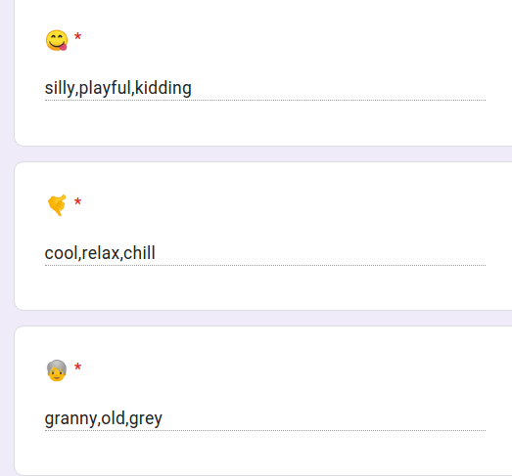
0️⃣ Introduction
The data is gathered using google forms / MTurk
Each emoji is described by 3 distinct words
An App script program generates the forms
Notes:
More than 3304 emojis in the unicode standard
used daily in huge amount of data
Conveys precious info about emotion and more
Goal consists in assessing how people agree on these emojis meaning
provide a valuable dataset to the community allowing nlp models to better grasp the meaning of these emojis.

Slide 6
1️⃣ Emojis Selection

Slide 7
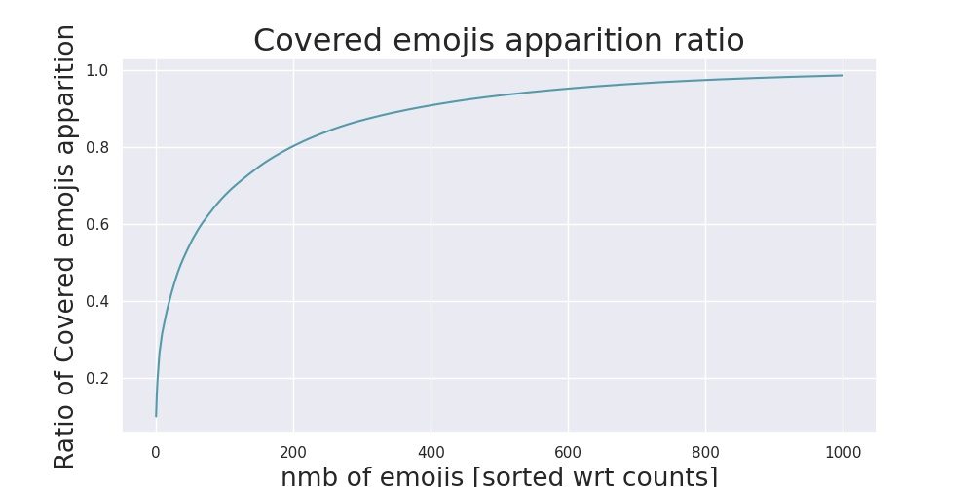
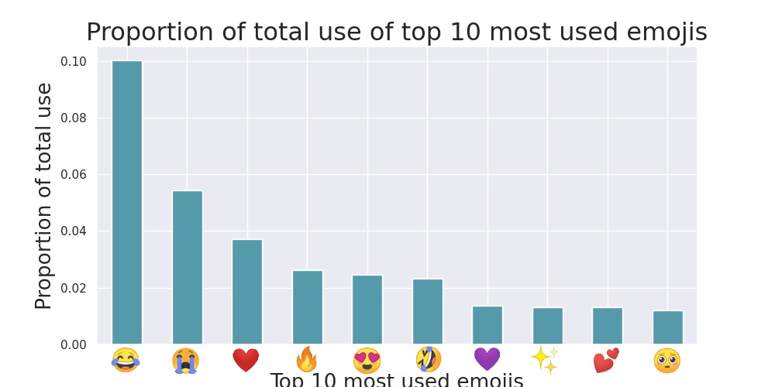
1️⃣ Emojis Selection
Notes:
Top 10 accounts for >31% of total emojis use in tweeter data

Slide 8
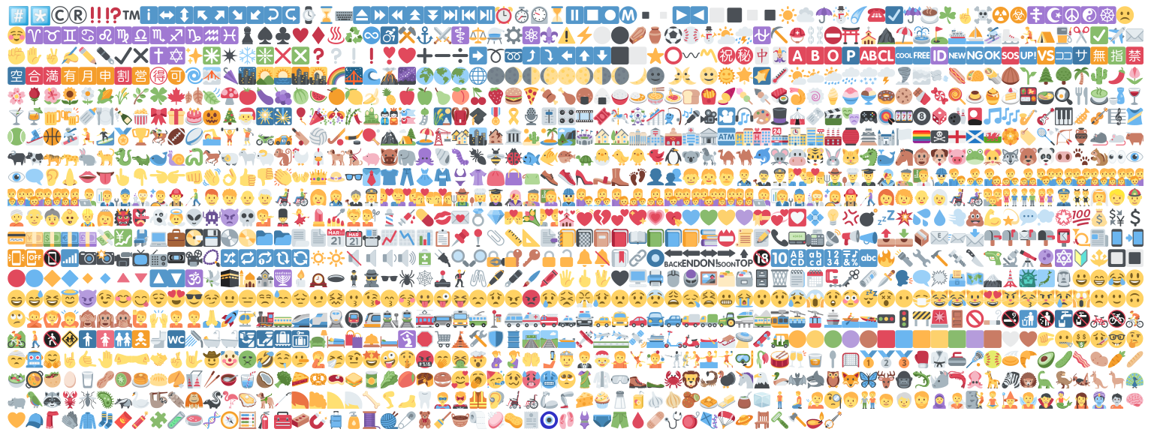
1️⃣ Emojis Selection
Notes:
Original length:3859
Removing flags and letters and numbers, Removing tones, Removing gender ⇒ 1325 emojis
Covers >94.7% of tweeter use

Slide 9
2️⃣ Quantity Needs

Slide 10
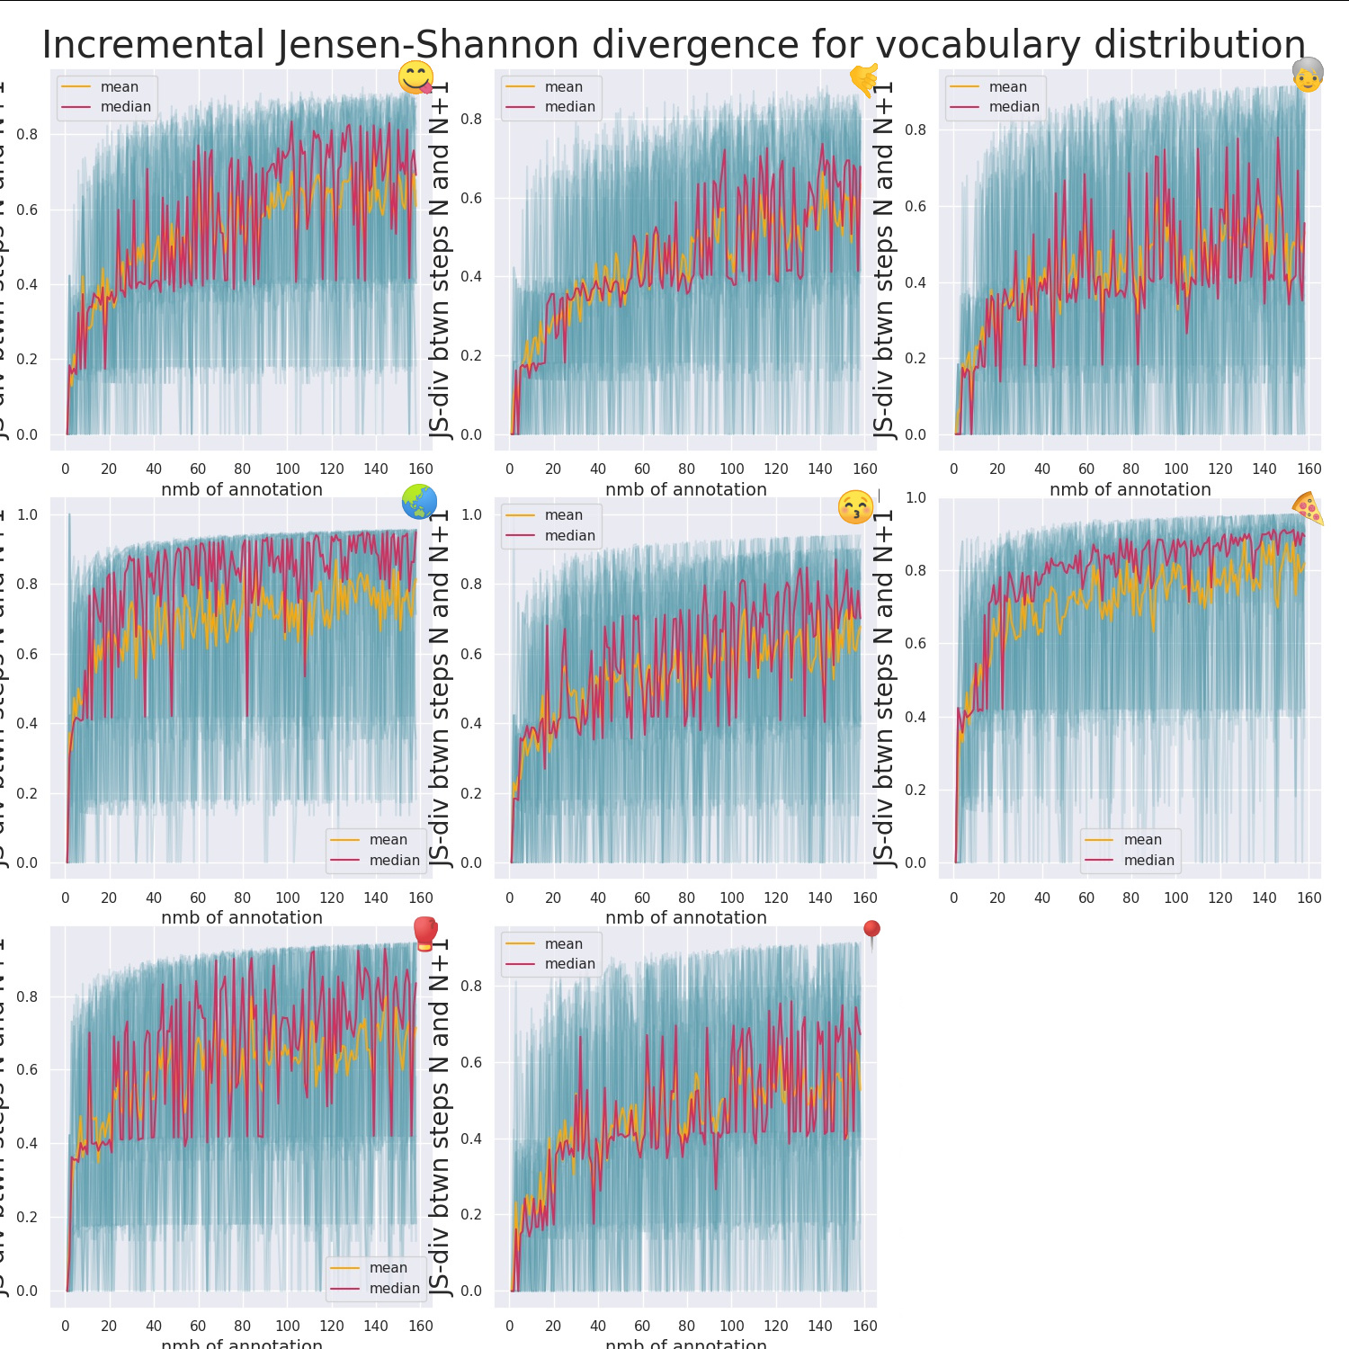
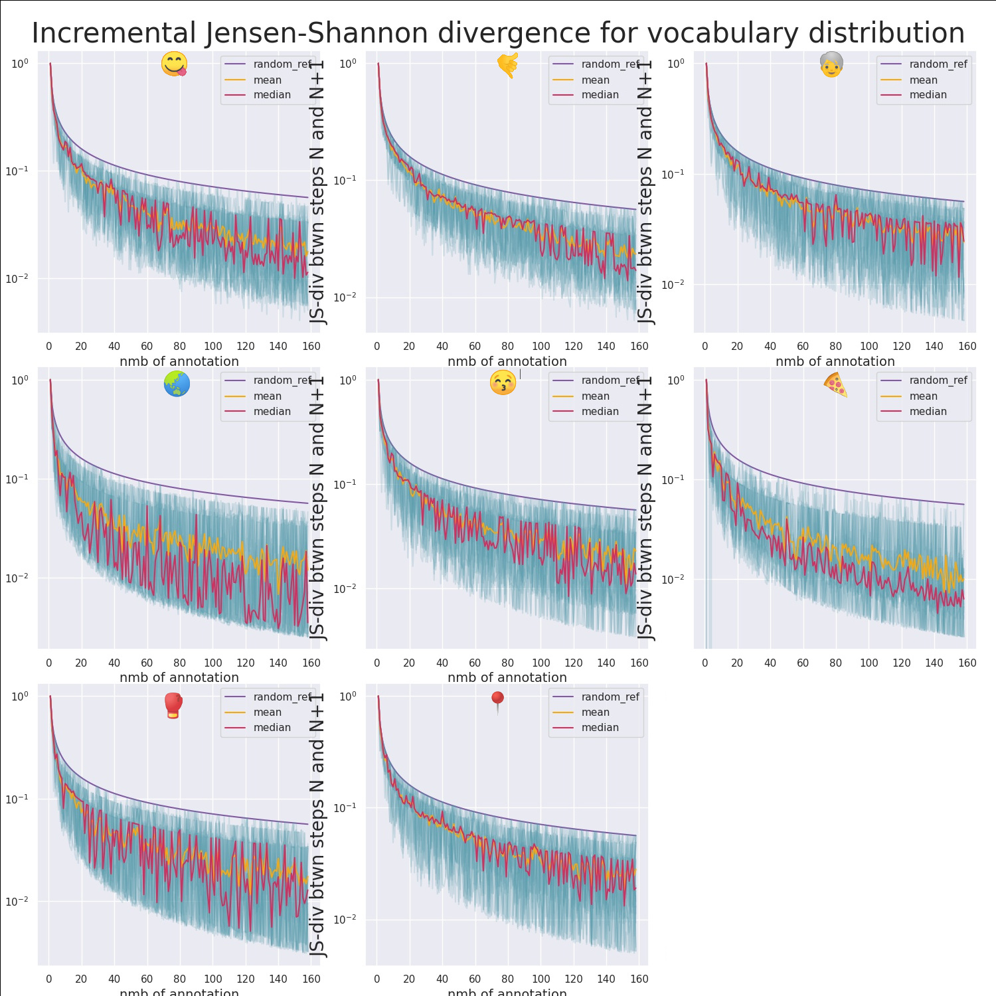
2️⃣ Quantity Needs

Slide 11
3️⃣ Data Collection

Slide 12


3️⃣ Data Collection
Amazon Mechanical Turk is a great tool! But:
No automatization of form creation
No server-side check for the answers
All these features are offered by Google forms. Can we get both?

Slide 13
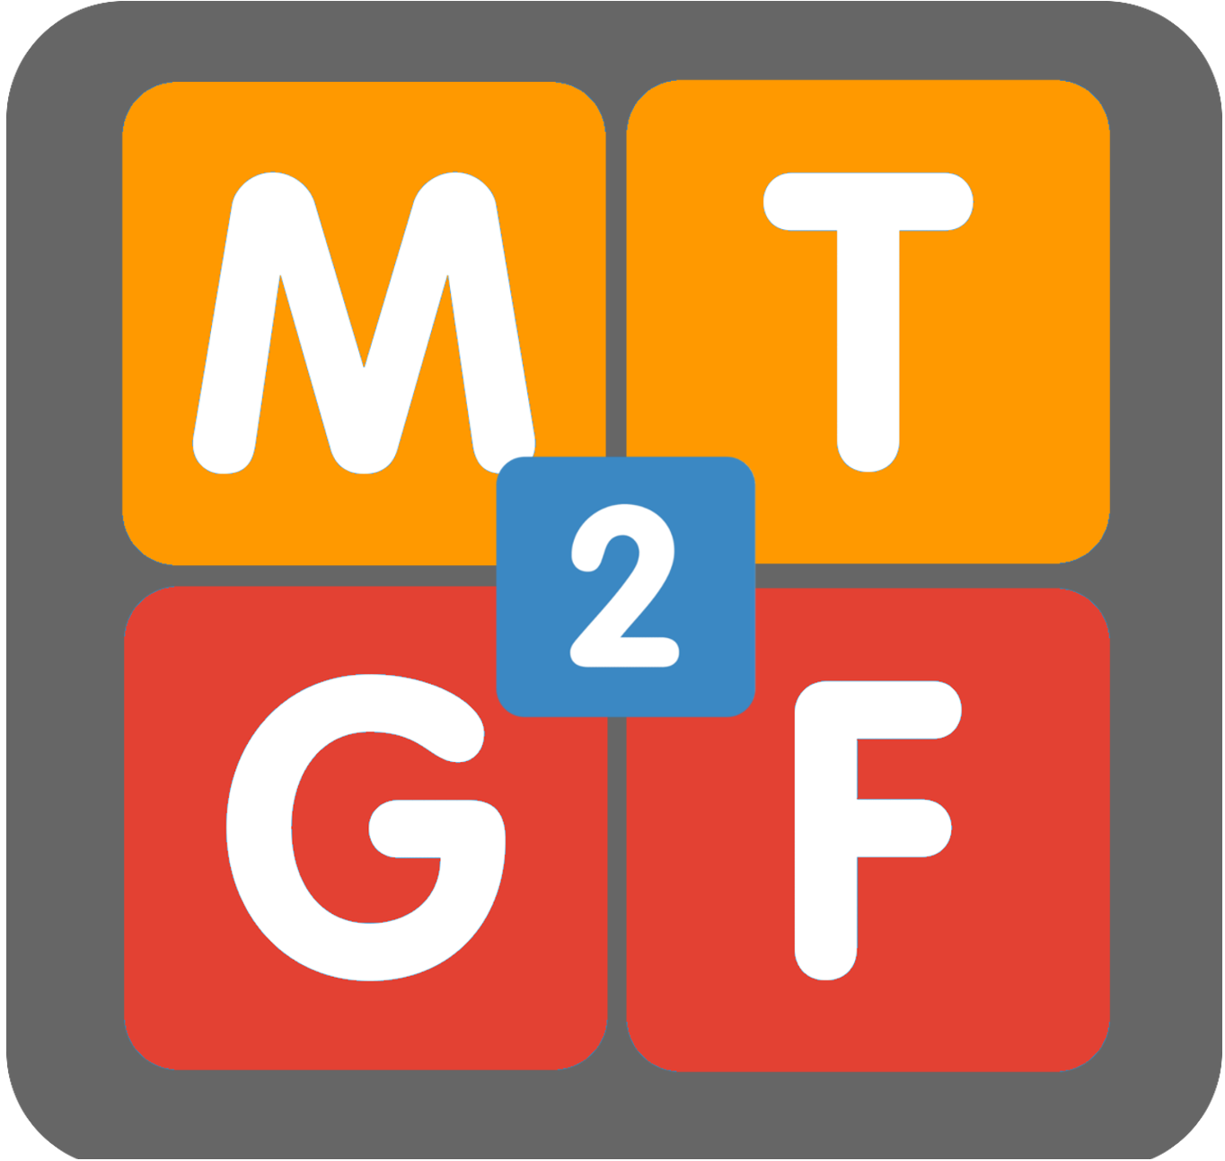
3️⃣ Data Collection

Slide 14
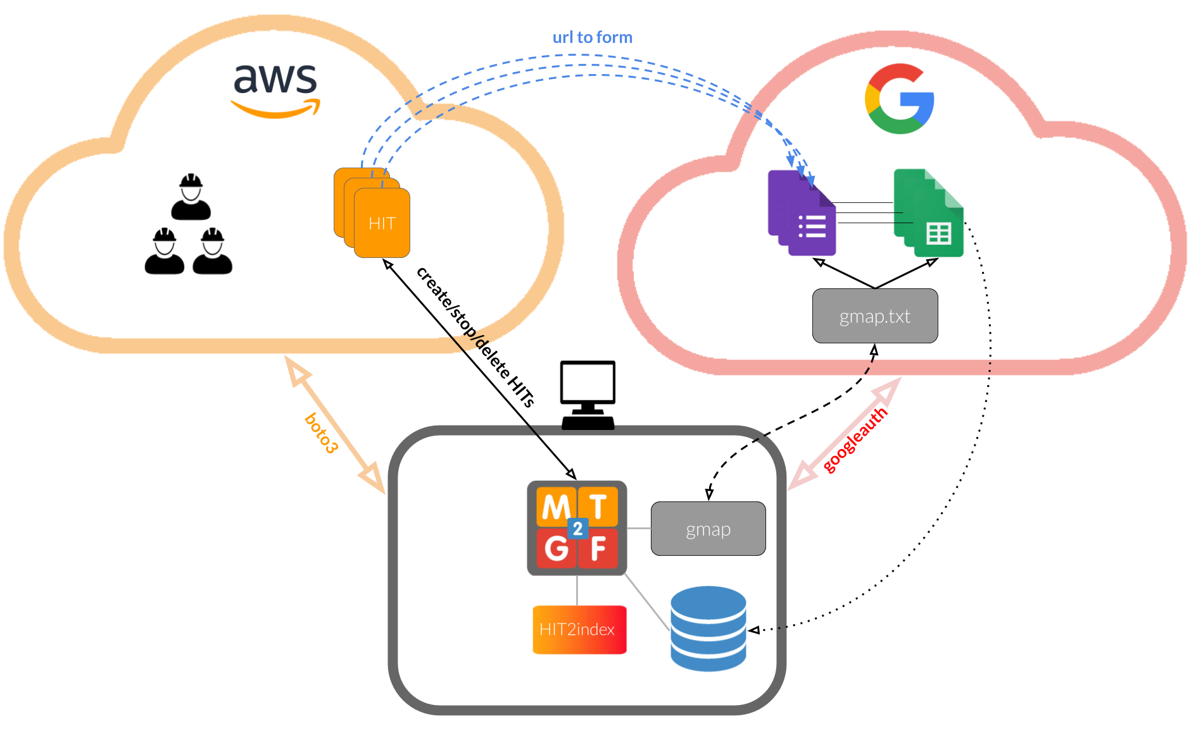
3️⃣ Data Collection

Slide 15
3️⃣ Data Collection
Notes:
Kristina comment:
-Presentation will have to be short. Make sure to have enough time to explain in detail each plot or demo such as this one so that it is cristal clear for people not familiar with the project.

Slide 16
4️⃣ Post-processing

Slide 17
4️⃣ Post-processing
3 quality-checks
Repeated Answers
Honeypots
Vocabulary Correction

Slide 18
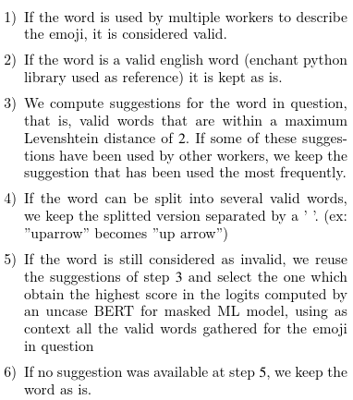
4️⃣ Post-processing
3 quality-checks
Repeated Answers
Honeypots
Vocabulary Correction

Slide 19
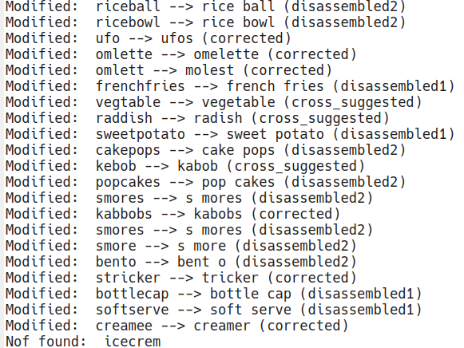
4️⃣ Post-processing
3 quality-checks
Repeated Answers
Honeypots
Vocabulary Correction

Slide 20
5️⃣ Validation

Slide 21
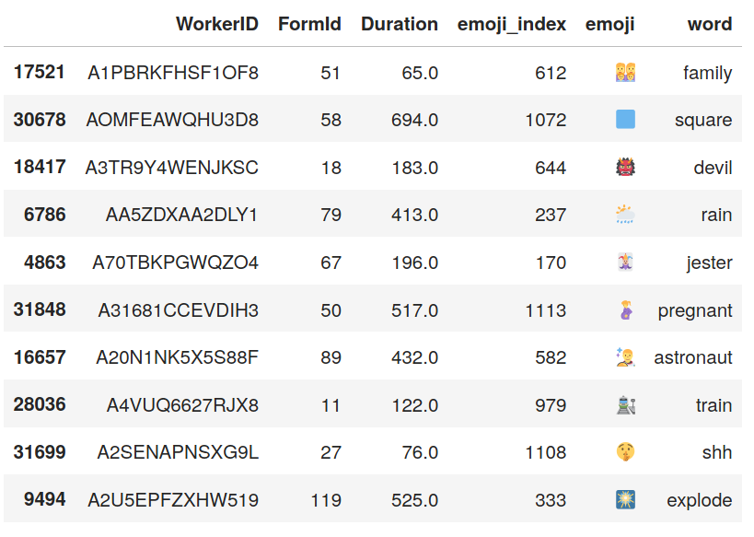
5️⃣ Validation

Slide 22
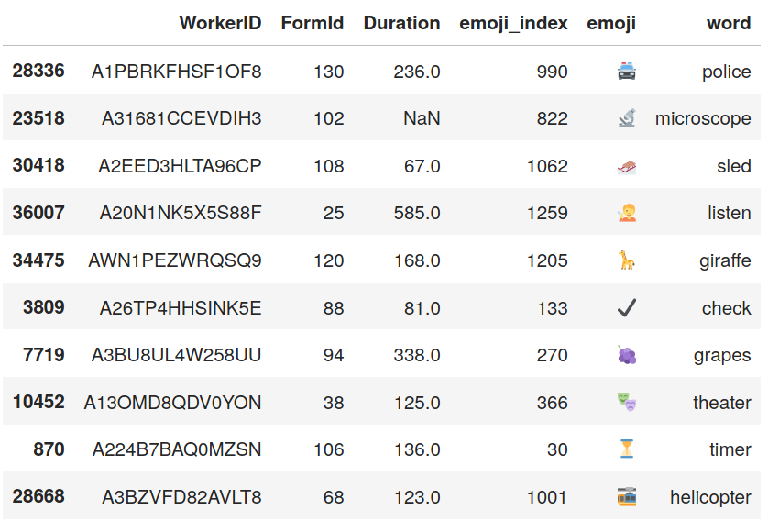
5️⃣ Validation

Slide 23
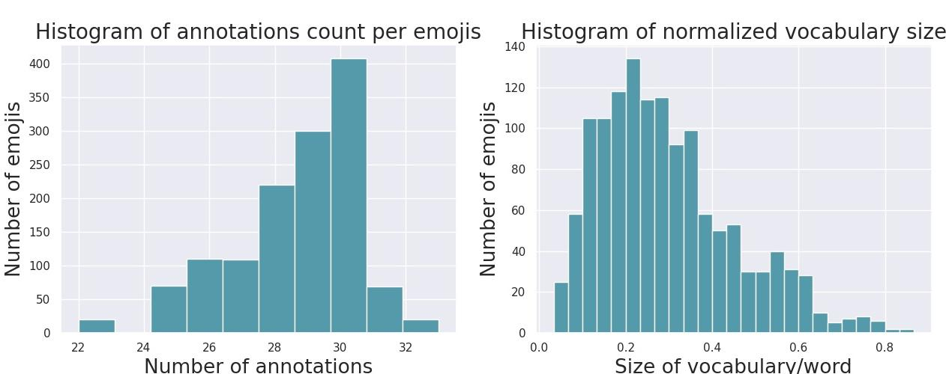
5️⃣ Validation

Slide 24
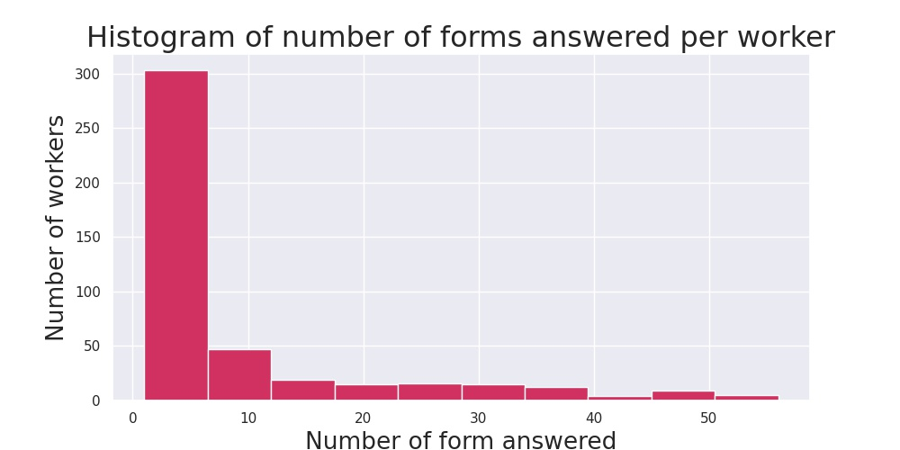
5️⃣ Validation

Slide 25
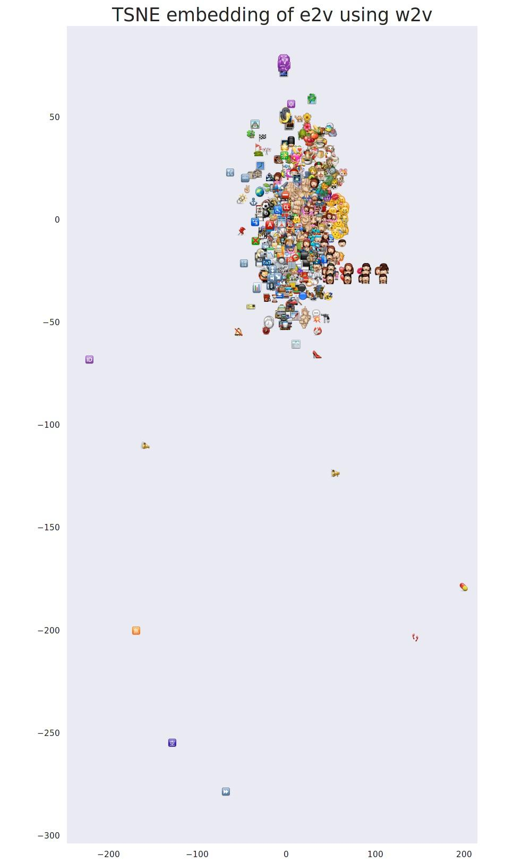
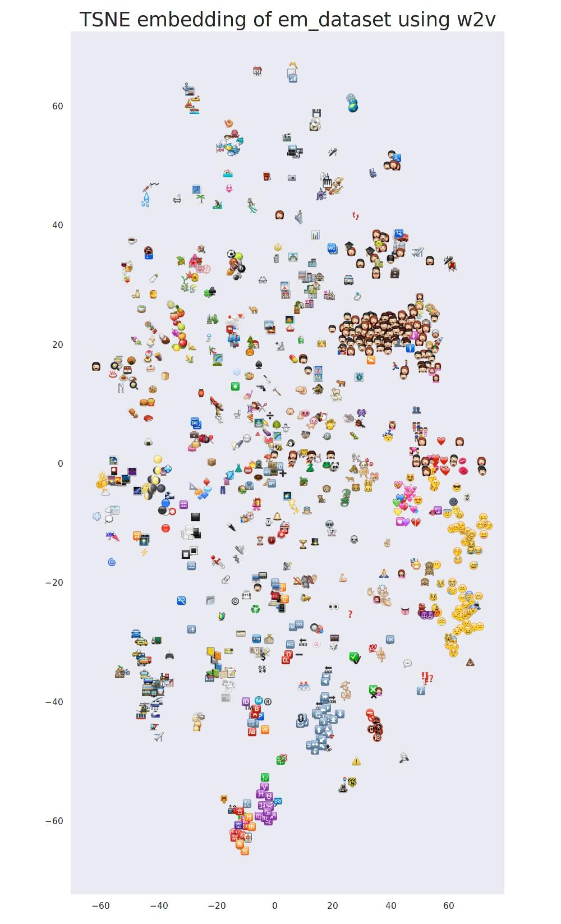
5️⃣ Validation
Word2vec embedding

Slide 26
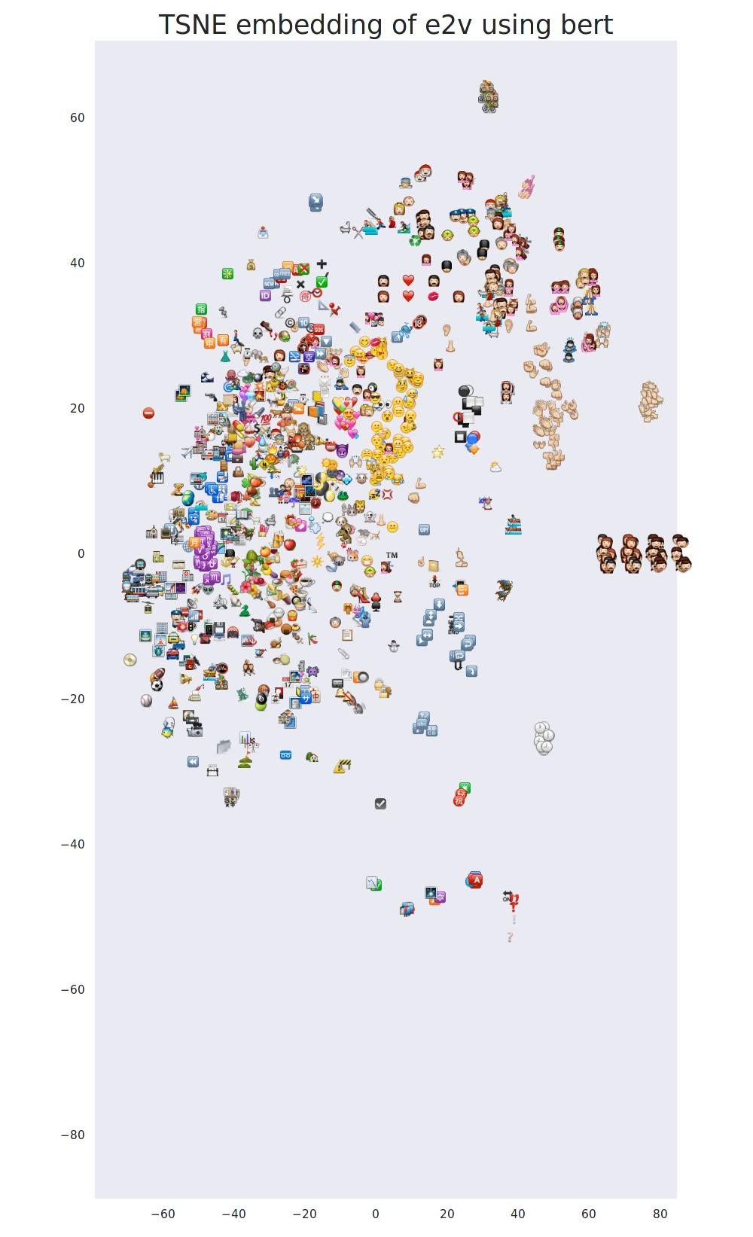
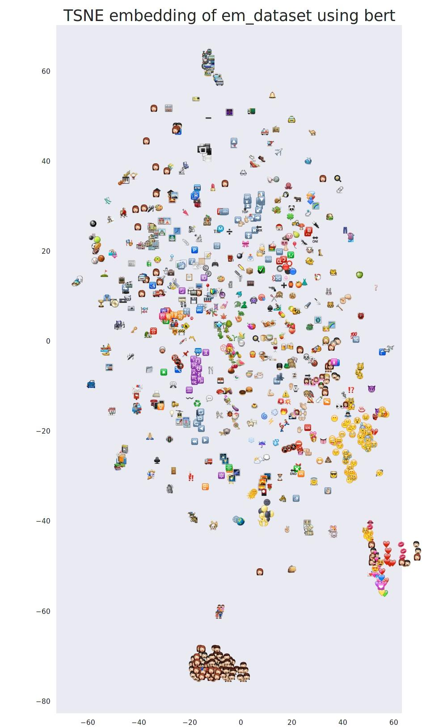
5️⃣ Validation
Bert embedding (last attention layer)
Notes:
Kristina comment:
-Show examples!! Can you show for 3,4 emojis what are the annotations we collected, e.g., 15xbannana, 3X fruit or similar. It would help a lot to grasp the data and how emojis are different (chose some abstract and some more concrete)

Slide 27
5️⃣ Conclusion
Dataset readily available
Would be interesting to implement a model-agnostic wrapper around BERT that takes these embeddings into account for emojis tokens

Slide 28
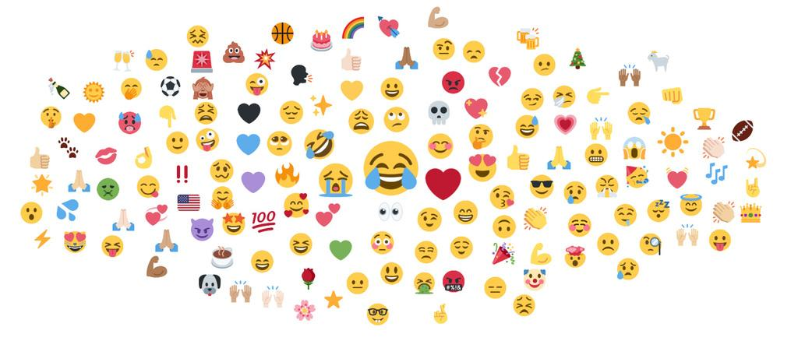
Thank you for your attention!

